Slide 1
Fortification learning to help detecting abuse in financial exchange description
Anuraj Bose
22MCB0011

Slide 2
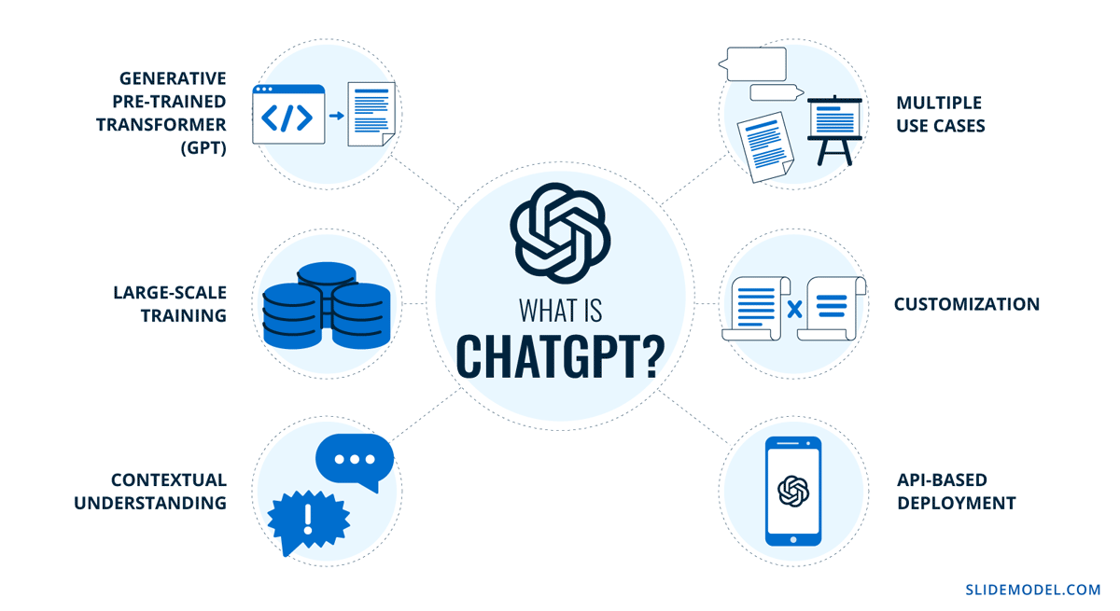
Slide Title
Make Effective Presentations
Using Awesome Backgrounds
Engage your Audience
Capture Audience Attention

Slide 3
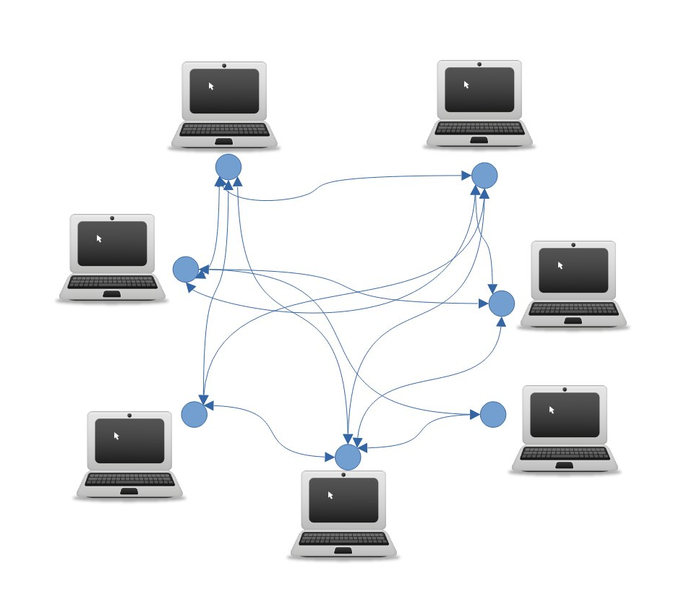
How this will work?
Peer to Peer

Slide 4
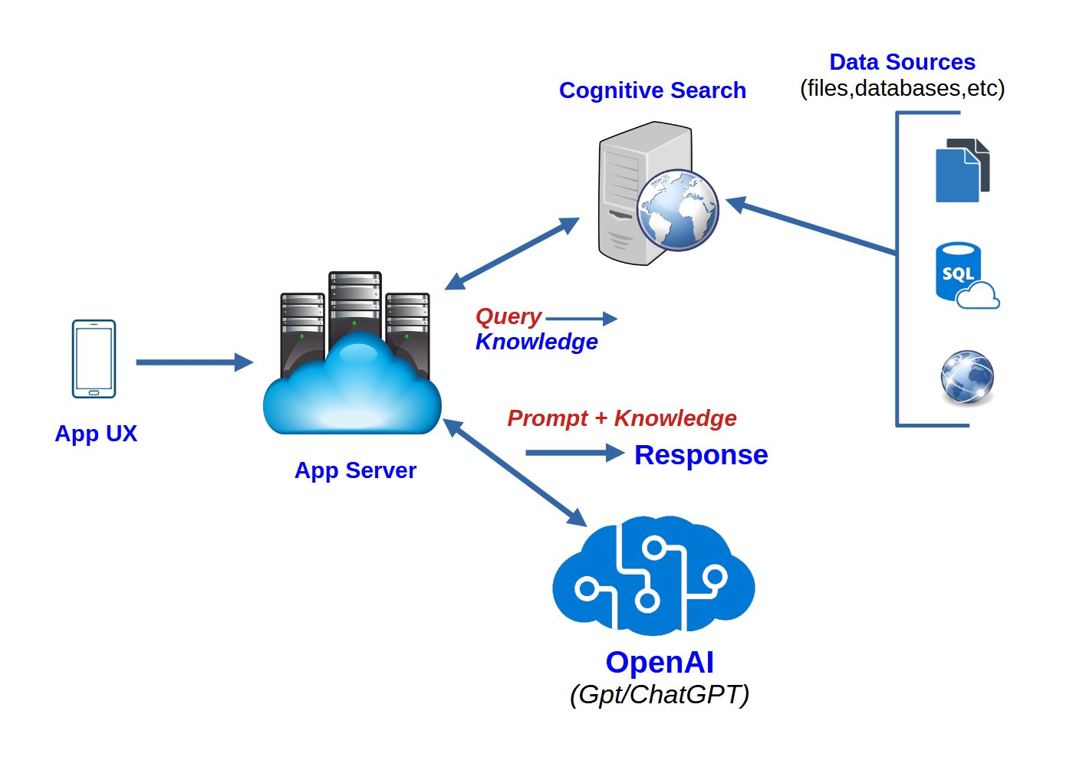
Enterprise Data with ChatGPT: Next-gen Apps W/ OpenAI and Cognitive Search

Slide 5
Why this is beneficial?
Faster Transactions
Streamlined Payment Processing
Merchant and Consumer Experiences
Predictive Analytics
Fraud Detection
E-commerce
Mobile Payments
B2B Payments

Slide 6
Faster Transactions
AI technology, like ChatGPT, can significantly speed up payment transactions by enabling real-time fraud detection and approval, which reduces the need for manual review and approval processes
AI utilises machine learning algorithms and predictive analytics. AI tools can analyse large volumes of data,
identify patterns and anomalies, and flag potential fraud attempts in real-time.
Then enabling payment providers to quickly and accurately approve or decline transactions.

Slide 7
Streamlined Payment Processing
AI tools can streamline payment processing by automating repetitive tasks,
reducing errors, and allowing players in the industry to focus on more strategic tasks.
By automating tasks such as data entry, reconciliation, and reporting,
AI technology can save time and improve efficiency for large merchants and acquirers.
This allows them to optimise the customer journey, identify new opportunities, and
manage risks more effectively. The use of AI in payment processing can provide a faster,
efficient, and accurate payment experience for customers.

Slide 8
Merchant and Consumer Experiences?
By using AI tools to analyse customer data, merchants can gain insights into consumer
preferences and behaviour, allowing them to personalise
their offerings and enhance the overall customer experience.
This can lead to increased customer loyalty and retention
Additionally, AI tools can help merchants streamline their operations and reduce processing times.
This results in faster and more efficient transactions for consumers.

Slide 9
Predictive Analytics
AI technology can also improve predictive analytics in the payments industry by
analysing vast amounts of customer data to identify patterns and trends.
This information can then be used to optimise the customer journey, identify new opportunities, and develop targeted marketing strategies.
AI tools like ChatGPT can analyse historical transaction data, social media activity, and demographic information to make predictions about future customer behaviour.

Slide 10
Fraud Detection
Traditional methods of detecting fraud are no longer sufficient, and fraudulent
activities cost the industry billions of dollars each year.
This is where AI tools can make a significant impact. These tools can analyse massive amounts of data in real-time,
detecting patterns and identifying potential fraudulent activities.

Slide 11
Mobile Payments
AI technology can also streamline mobile payments by automating the payment process and making it more user-friendly.
With the increasing use of smartphones and mobile devices,
mobile payments are becoming more popular among consumers.

Slide 12
E-commerce
AI technology has the potential to improve the ecommerce shopping cart experience in several ways.
Firstly, it can enhance the shopping cart’s ability to personalise the customer’s journey.
For example, AI can analyse the customer’s browsing and purchase history to suggest complementary products.

Slide 13
B2B Payments
AI-powered invoice processing can automate the manual process of data entry, reduce errors, and speed up the payment process. AI can also improve payment reconciliation by automatically matching incoming payments with outstanding invoices, reducing the need for manual intervention.
AI can help to identify potential payment delays. Such as disputes or other issues, allowing businesses to take proactive measures to resolve them. This not only
Speeds up the payment process but also improves the accuracy of payment data.
It helps to establish stronger business relationships.

Slide 14
Use Cases For ChatGPT In The Banking Industry
Virtual Assistants for Banking
Risk Management
Customer Onboarding
Know Your Customer (KYC) and Anti-Money Laundering (AML)
Financial Planning
Wealth Management
Loan Origination
Customer Service

Slide 15
What are the Challenges of Using ChatGPT in Payments?
Data Privacy and Security
Accuracy and Trustworthiness
Regulatory Compliance
Integration with Existing Systems
Language Limitations
User Acceptance and Adoption

Slide 16
Questions??

Slide 17
Thank You

